Slide 1

Project Report
Vim’s
Story
dotCOMTeam

Slide 2
Background
The current version of Vim’s story is so simple and less feature:
Users can only access the website and read book, it’s so negative when reader can’t contribute their ideas, their stories to others through Vim’s Story.
Sometimes, readers want to express their thought about the stories they read, it’s so boring.

Slide 3
Goal
Develop a new version of Vim’s Story
Include more features that head to the readers
Change UI layout for a better UX

Slide 4
Solution
In this case, we suggest a solution, that is:
Register feature for readers
Readers can contribute their stories for website
They can edit their information, change password
They can express their emotion by reacting, commenting
They can follow their favorite contributor
Admin can censor stories uploaded by contributor
Implement search feature

Slide 5
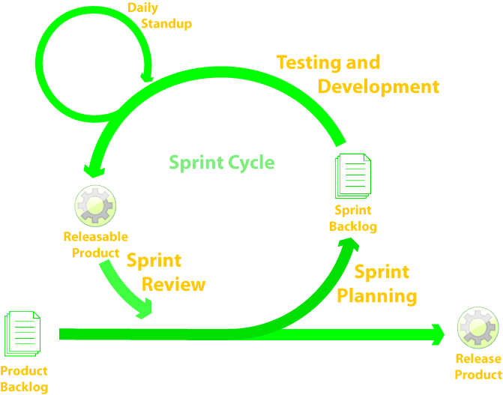
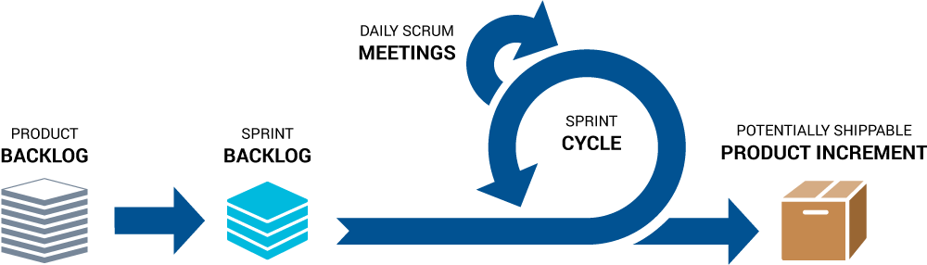
Process
Scrum Methodology

Slide 6
Process
Scrum is an iterative and incremental agile software development framework for managing software projects and product or application development.
Scrum focuses on project management institutions where it is difficult to plan ahead.
Mechanisms of empirical process control, where feedback loops that constitute the core management technique are used as opposed to traditional command-and-control management.
Its approach to planning and managing projects is by bringing decision-making authority to the level of operation properties and certainties.

Slide 7
Benefits of Scrum Methodology
Project can respond easily to change.
Problems are identified early.
Customer gets most beneficial work first.
Work done will better meet the customer’s needs.
Improved productivity.
Ability to maintain a predictable schedule for delivery.

Slide 8
Sprint 0
Setup teamboard.
Implement team name, team logo and slogan.
Definition of “Done”.
Setup environment for all computers:
Git
MySQL
NodeJS
Implement team rules.

Slide 9
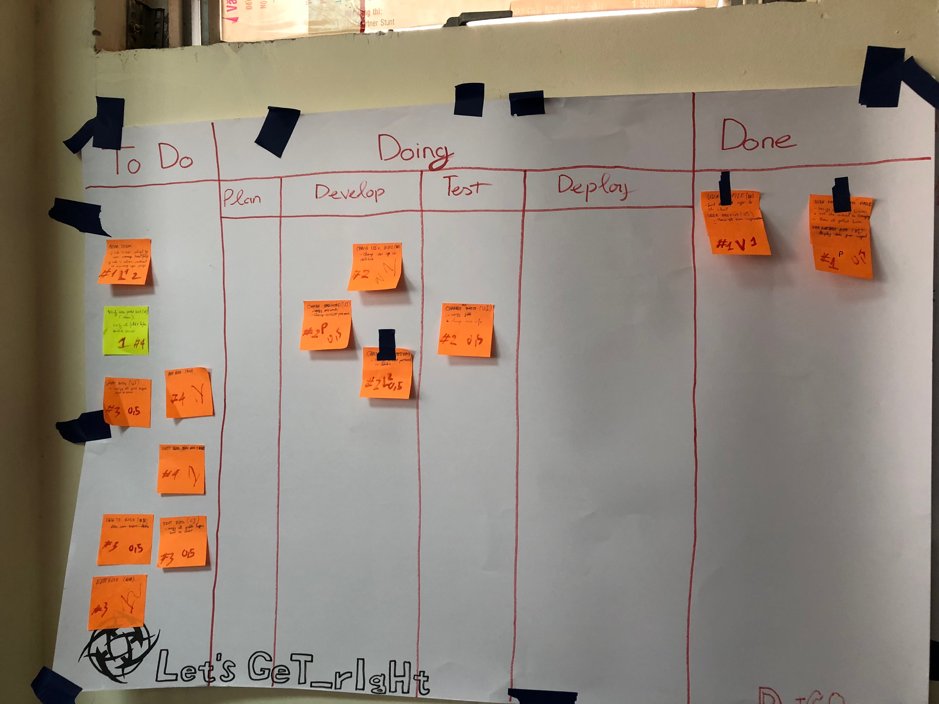
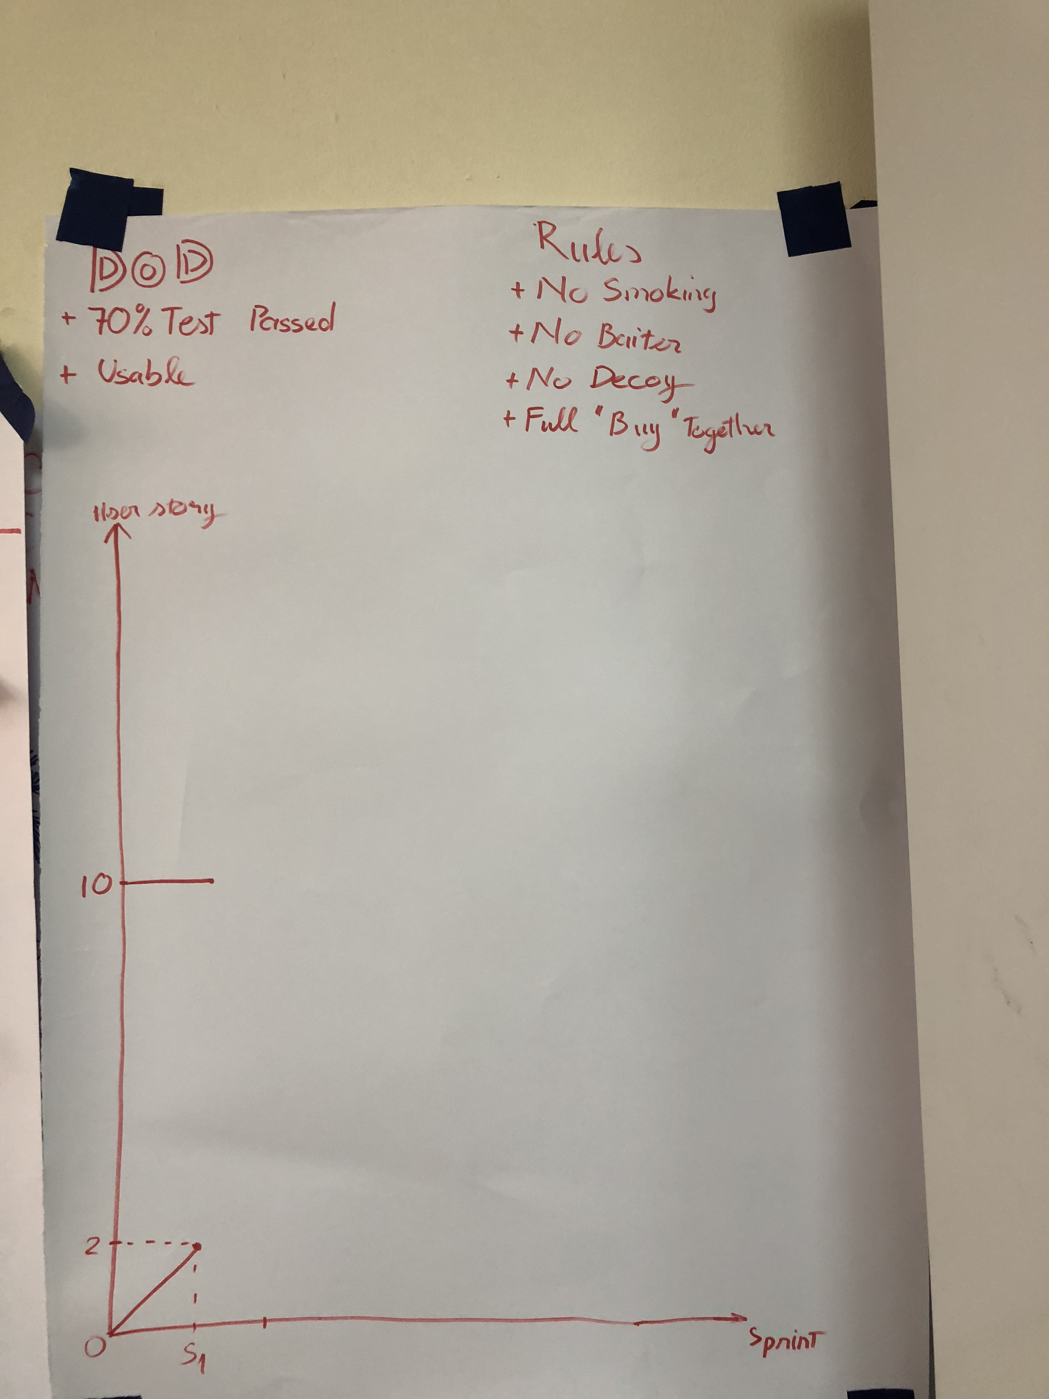
Sprint 1

Slide 10
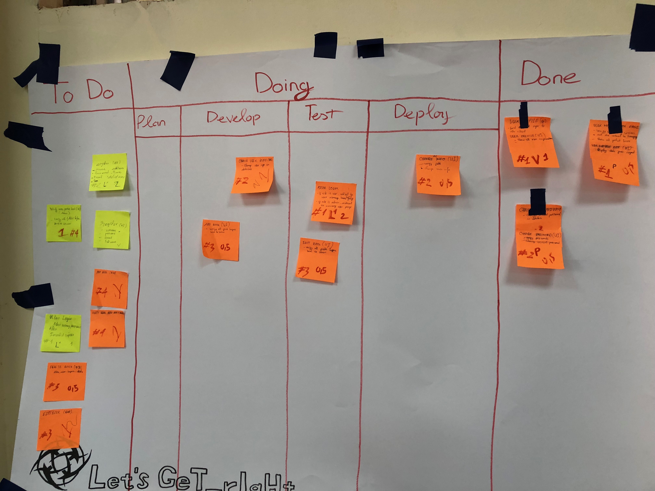
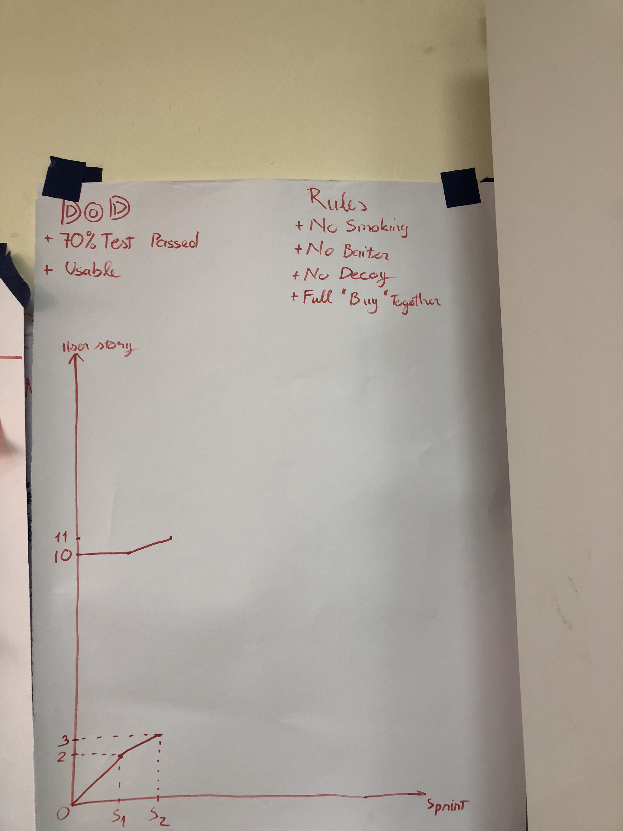
Sprint 2

Slide 11
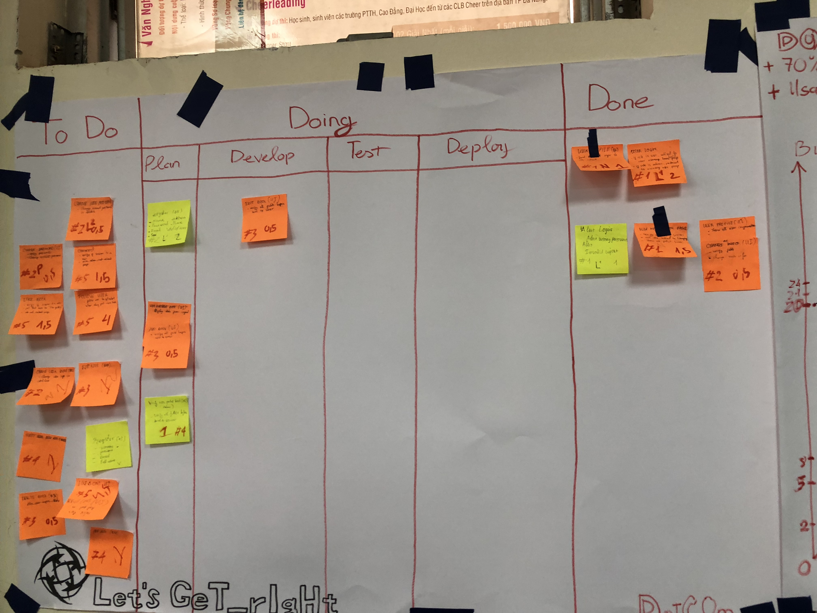
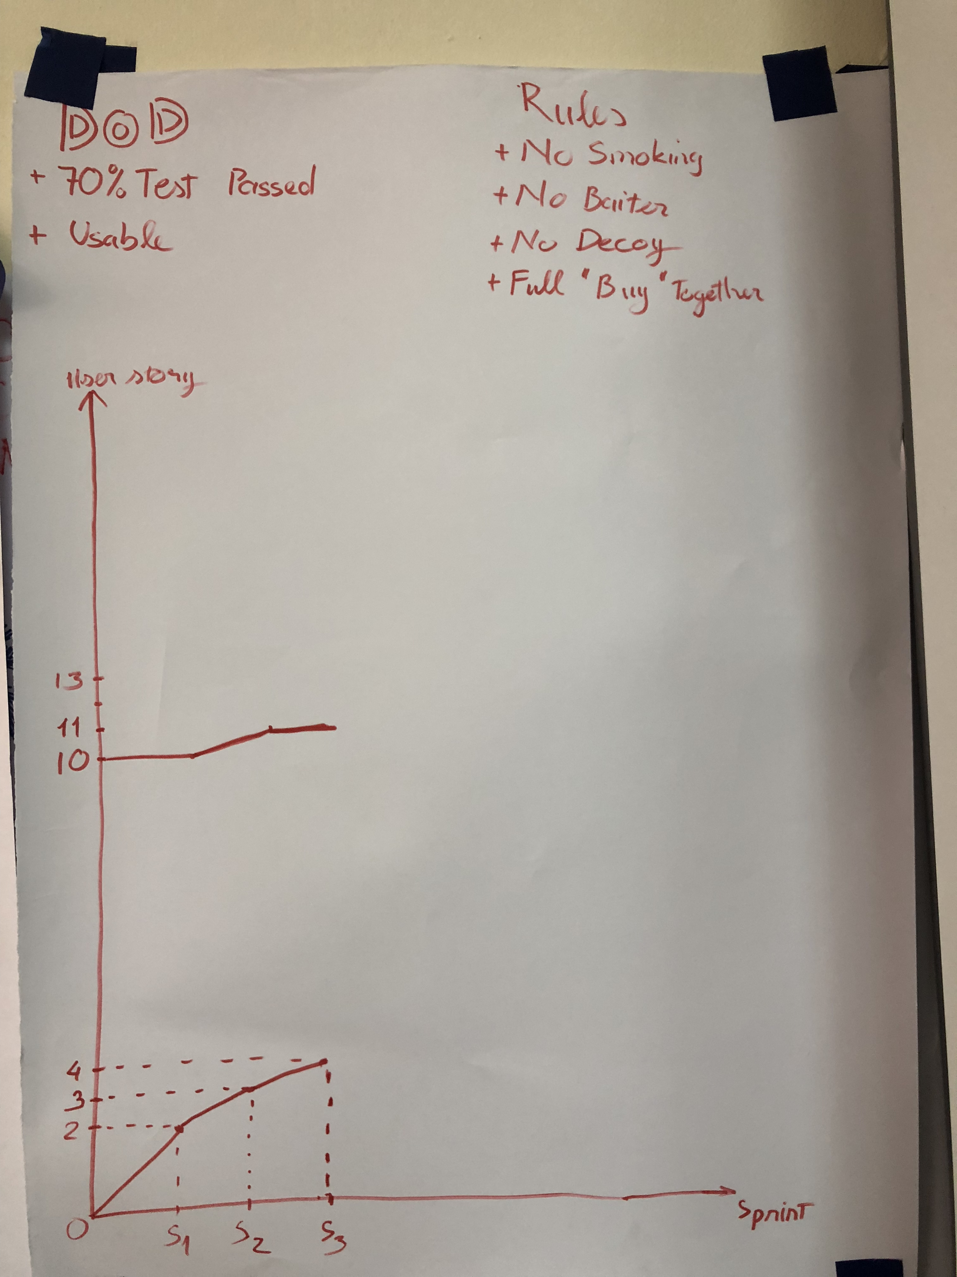
Sprint 3

Slide 12
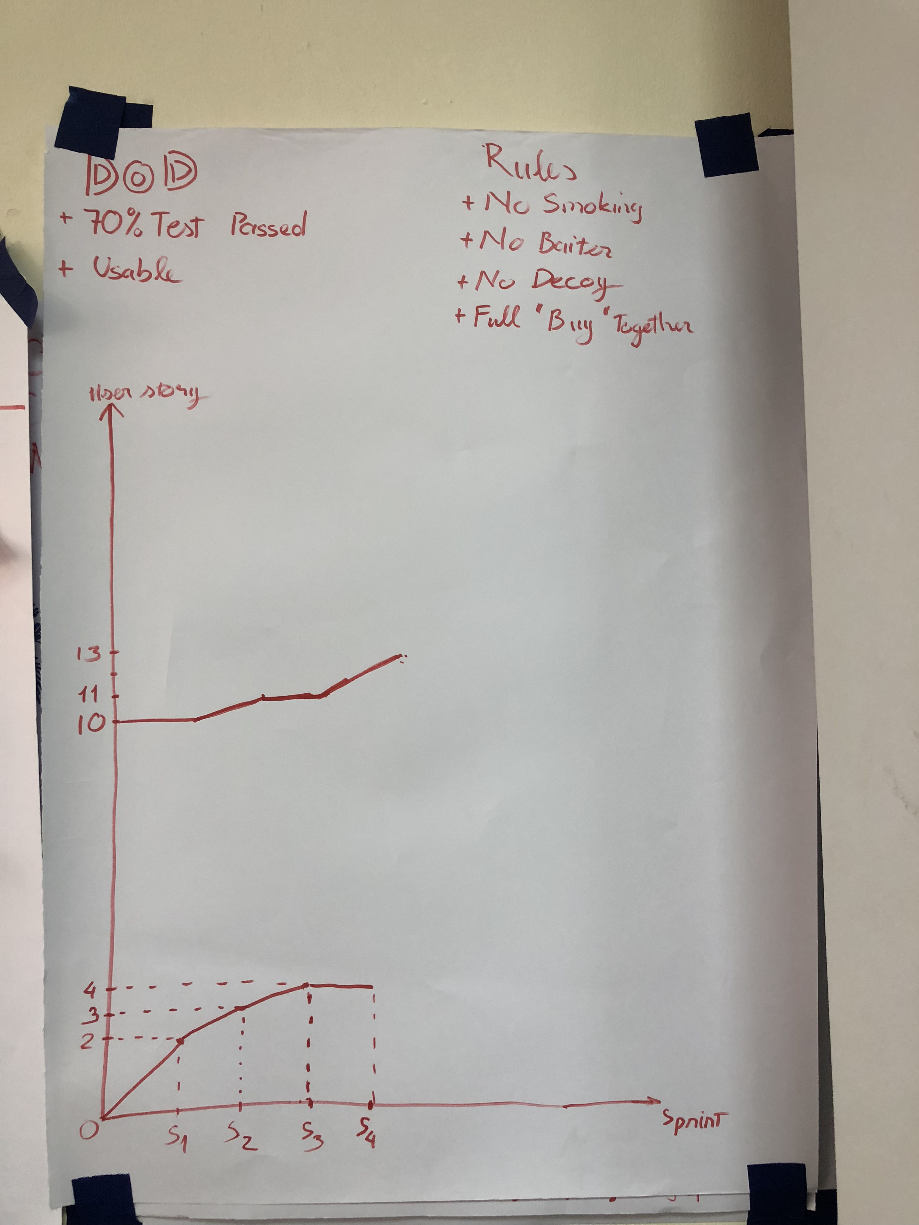
Sprint 4

Slide 13
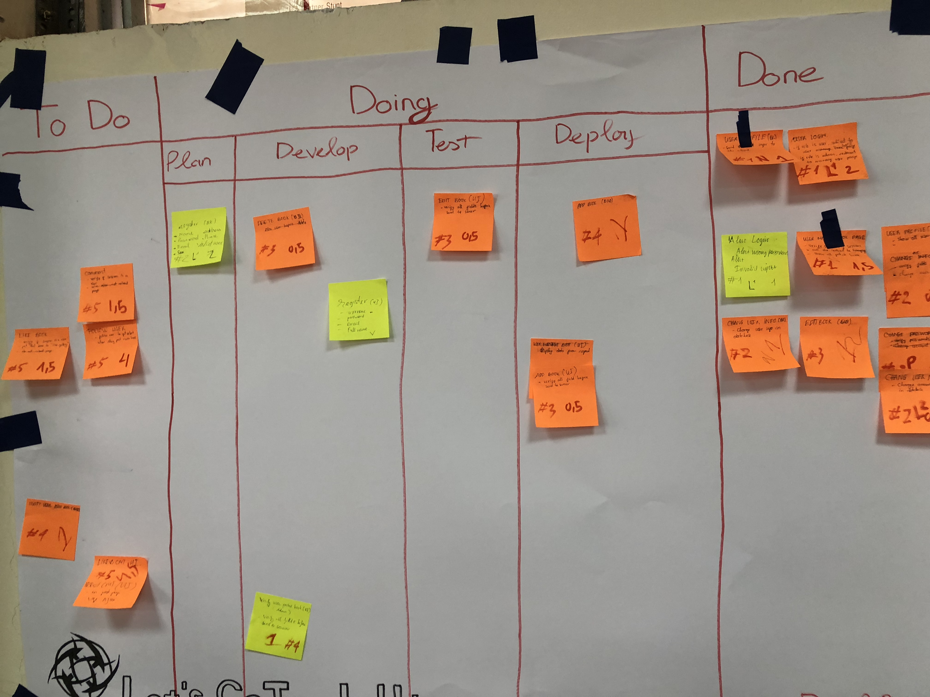
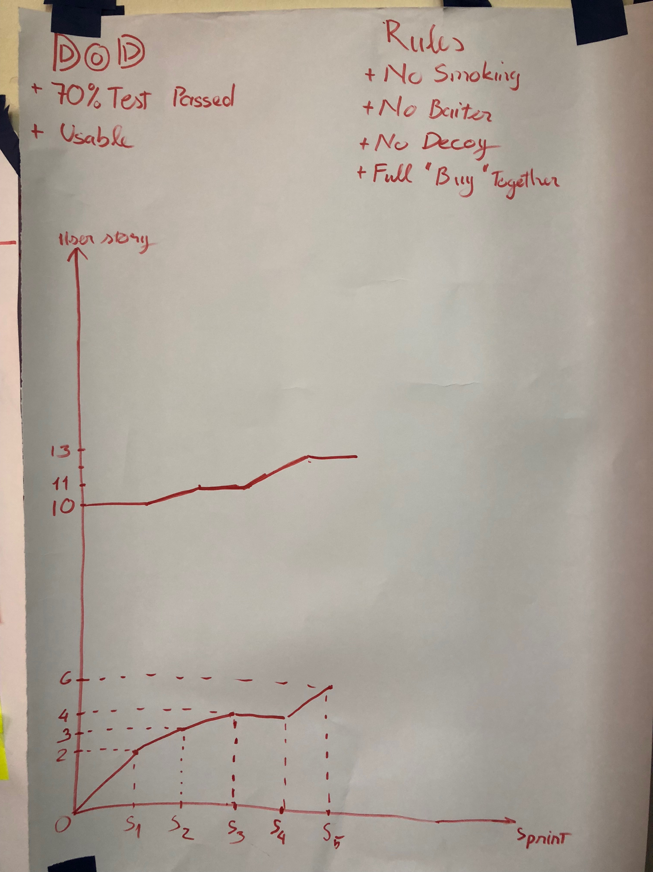
Sprint 5

Slide 14
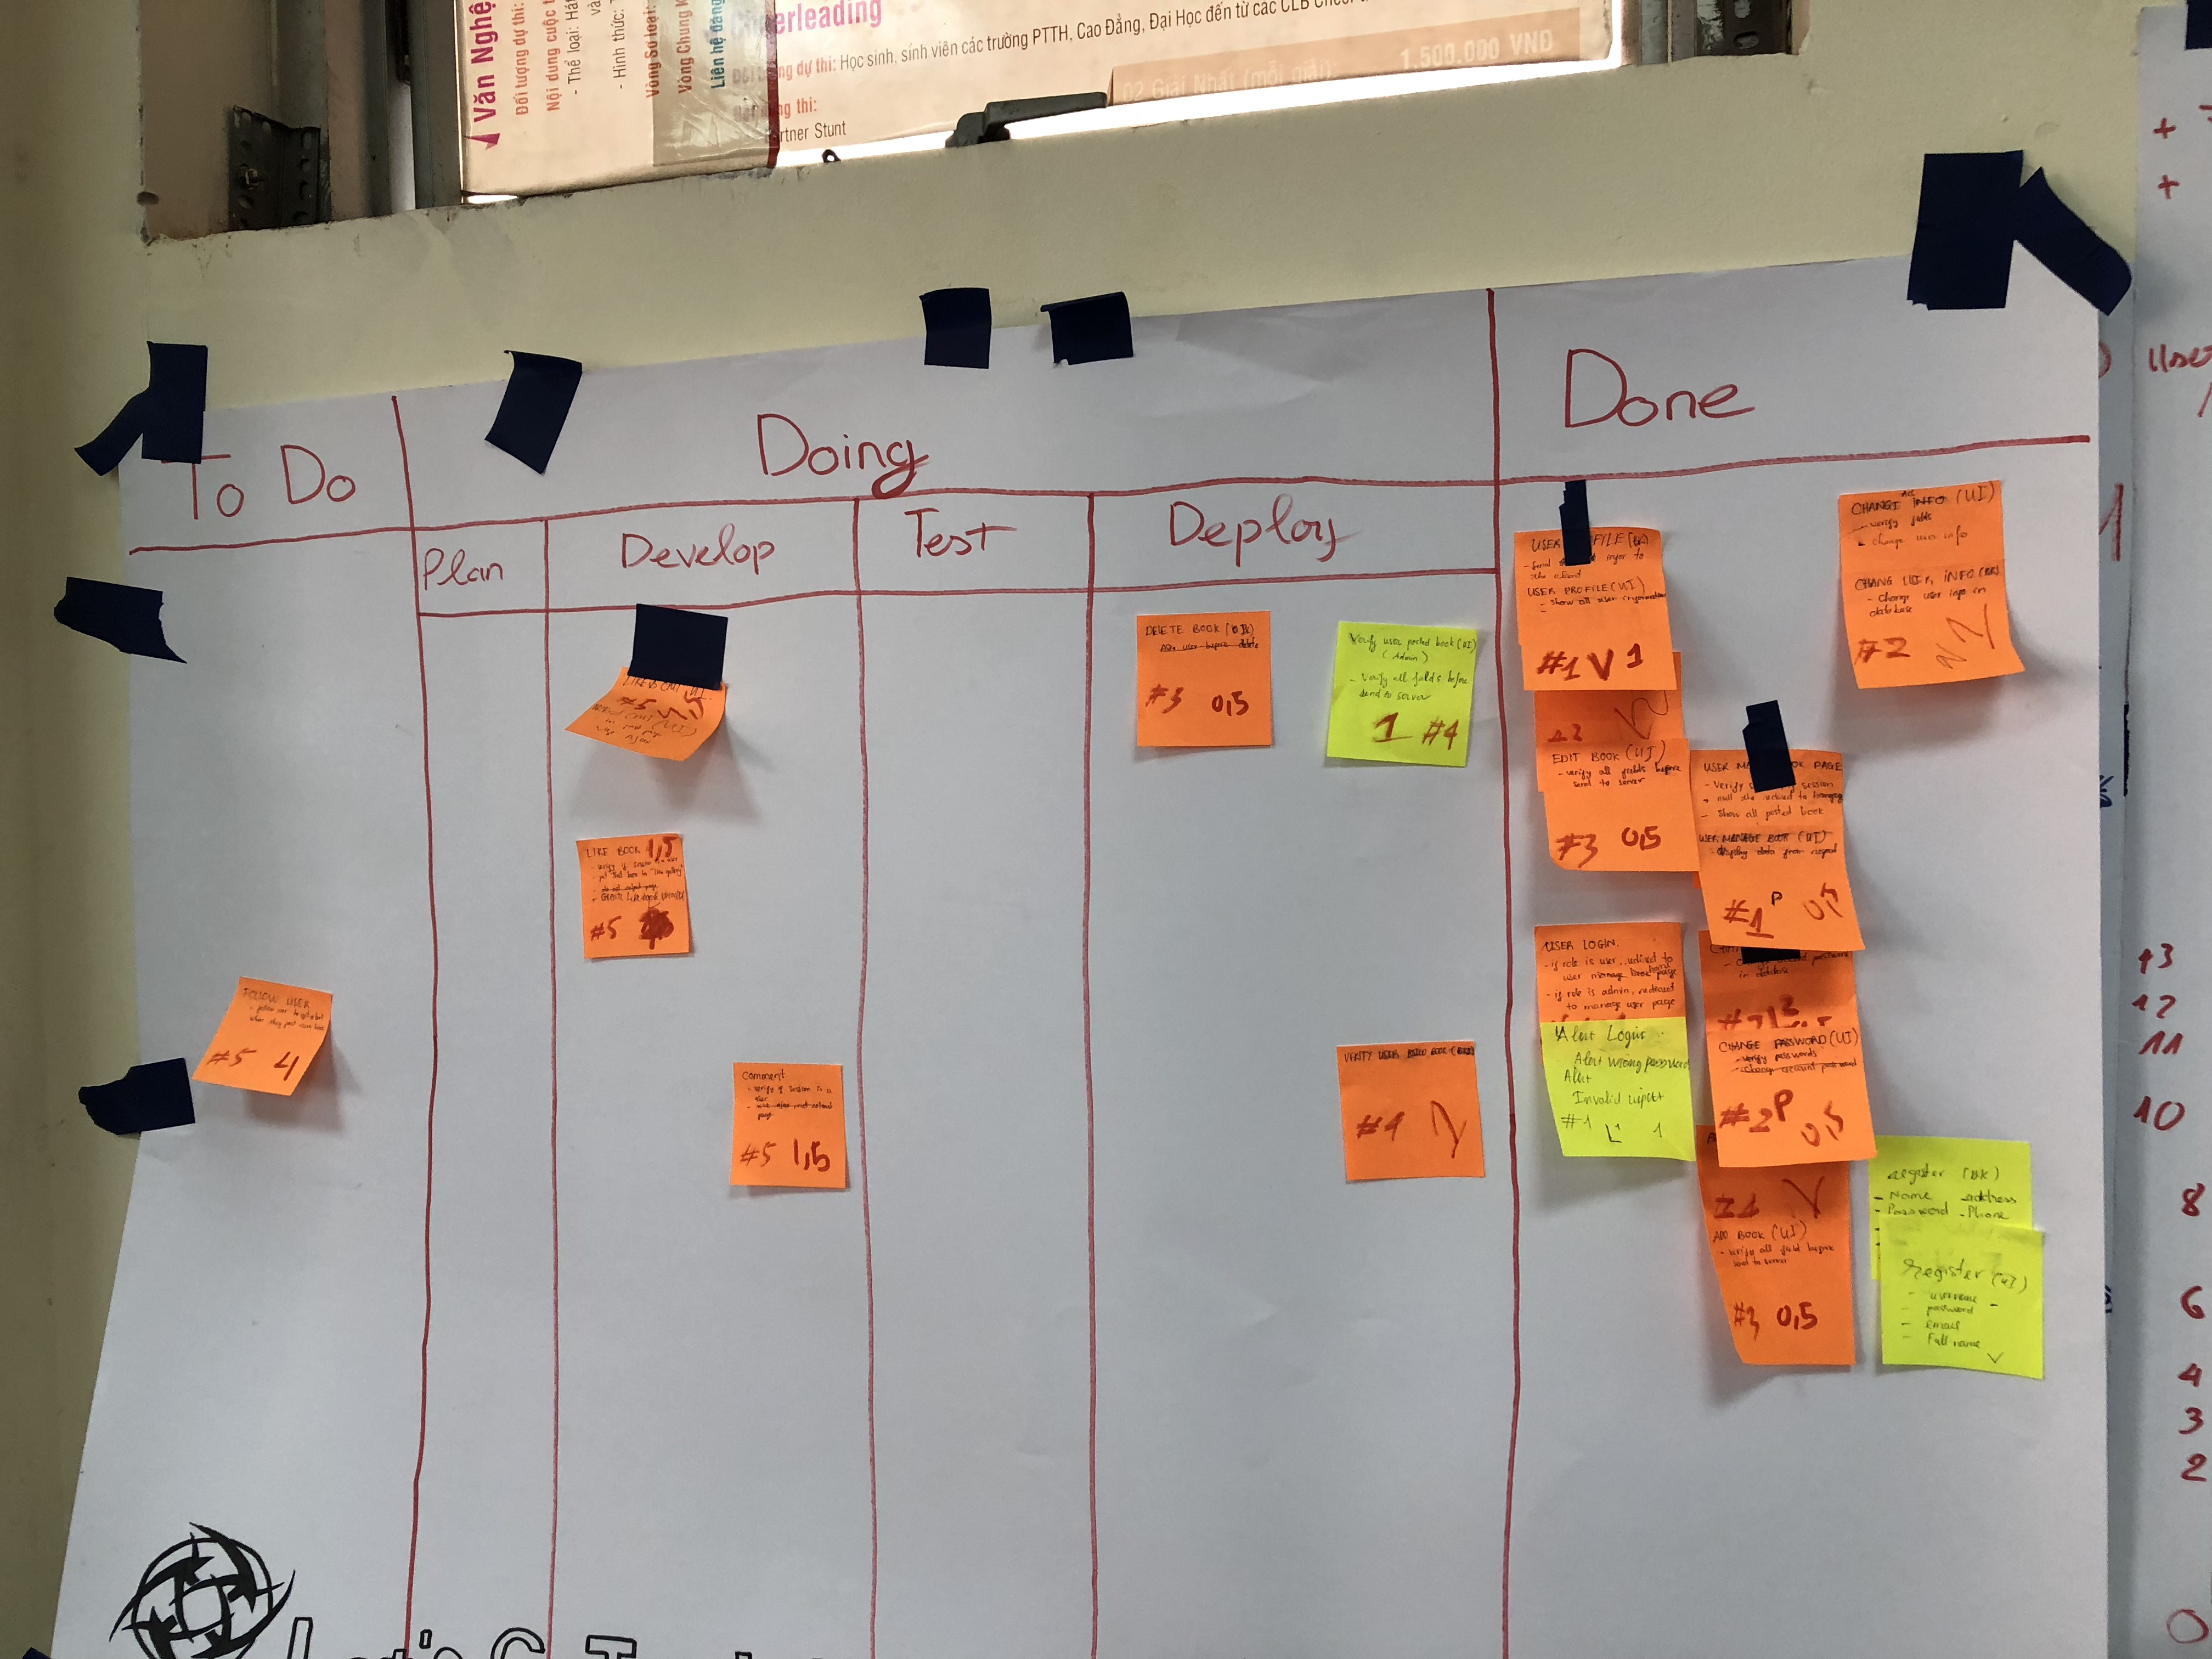
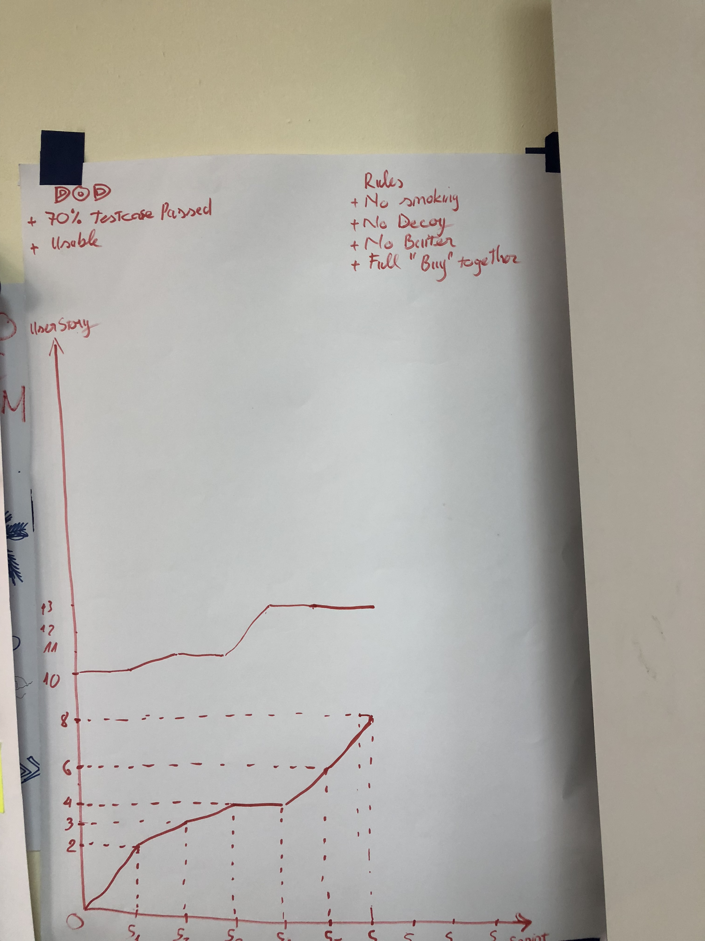
Sprint 6

Slide 15
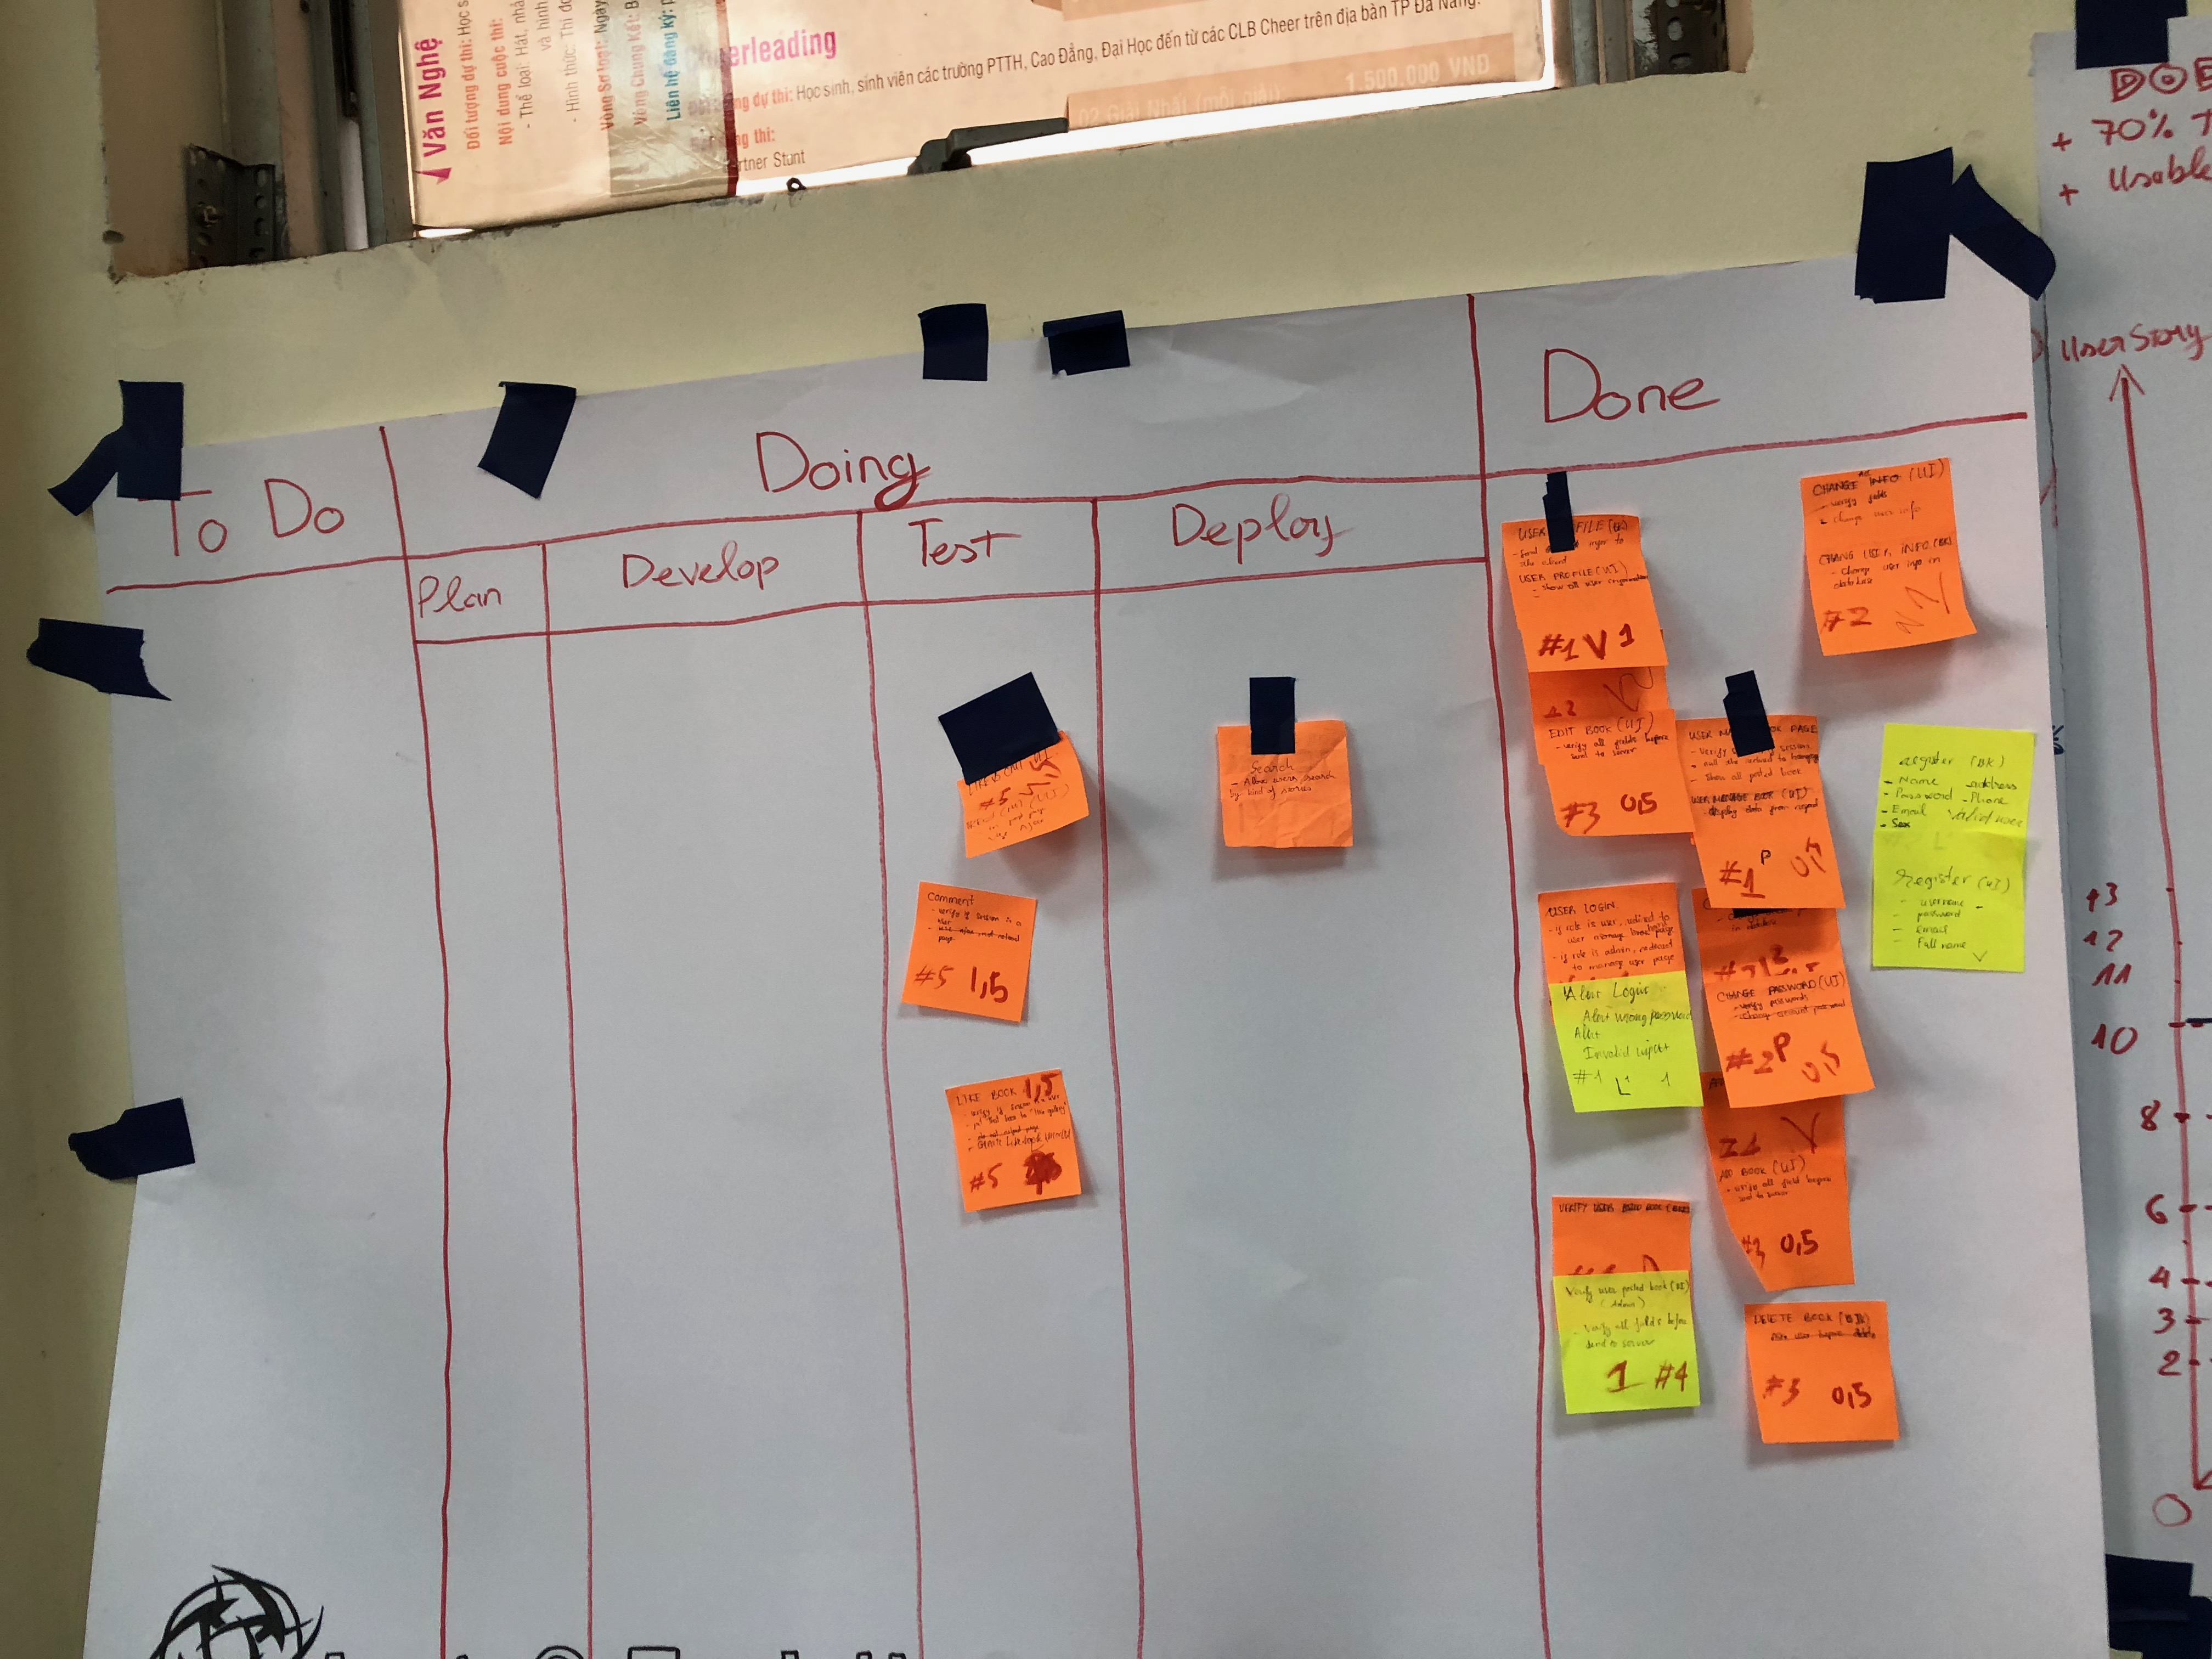
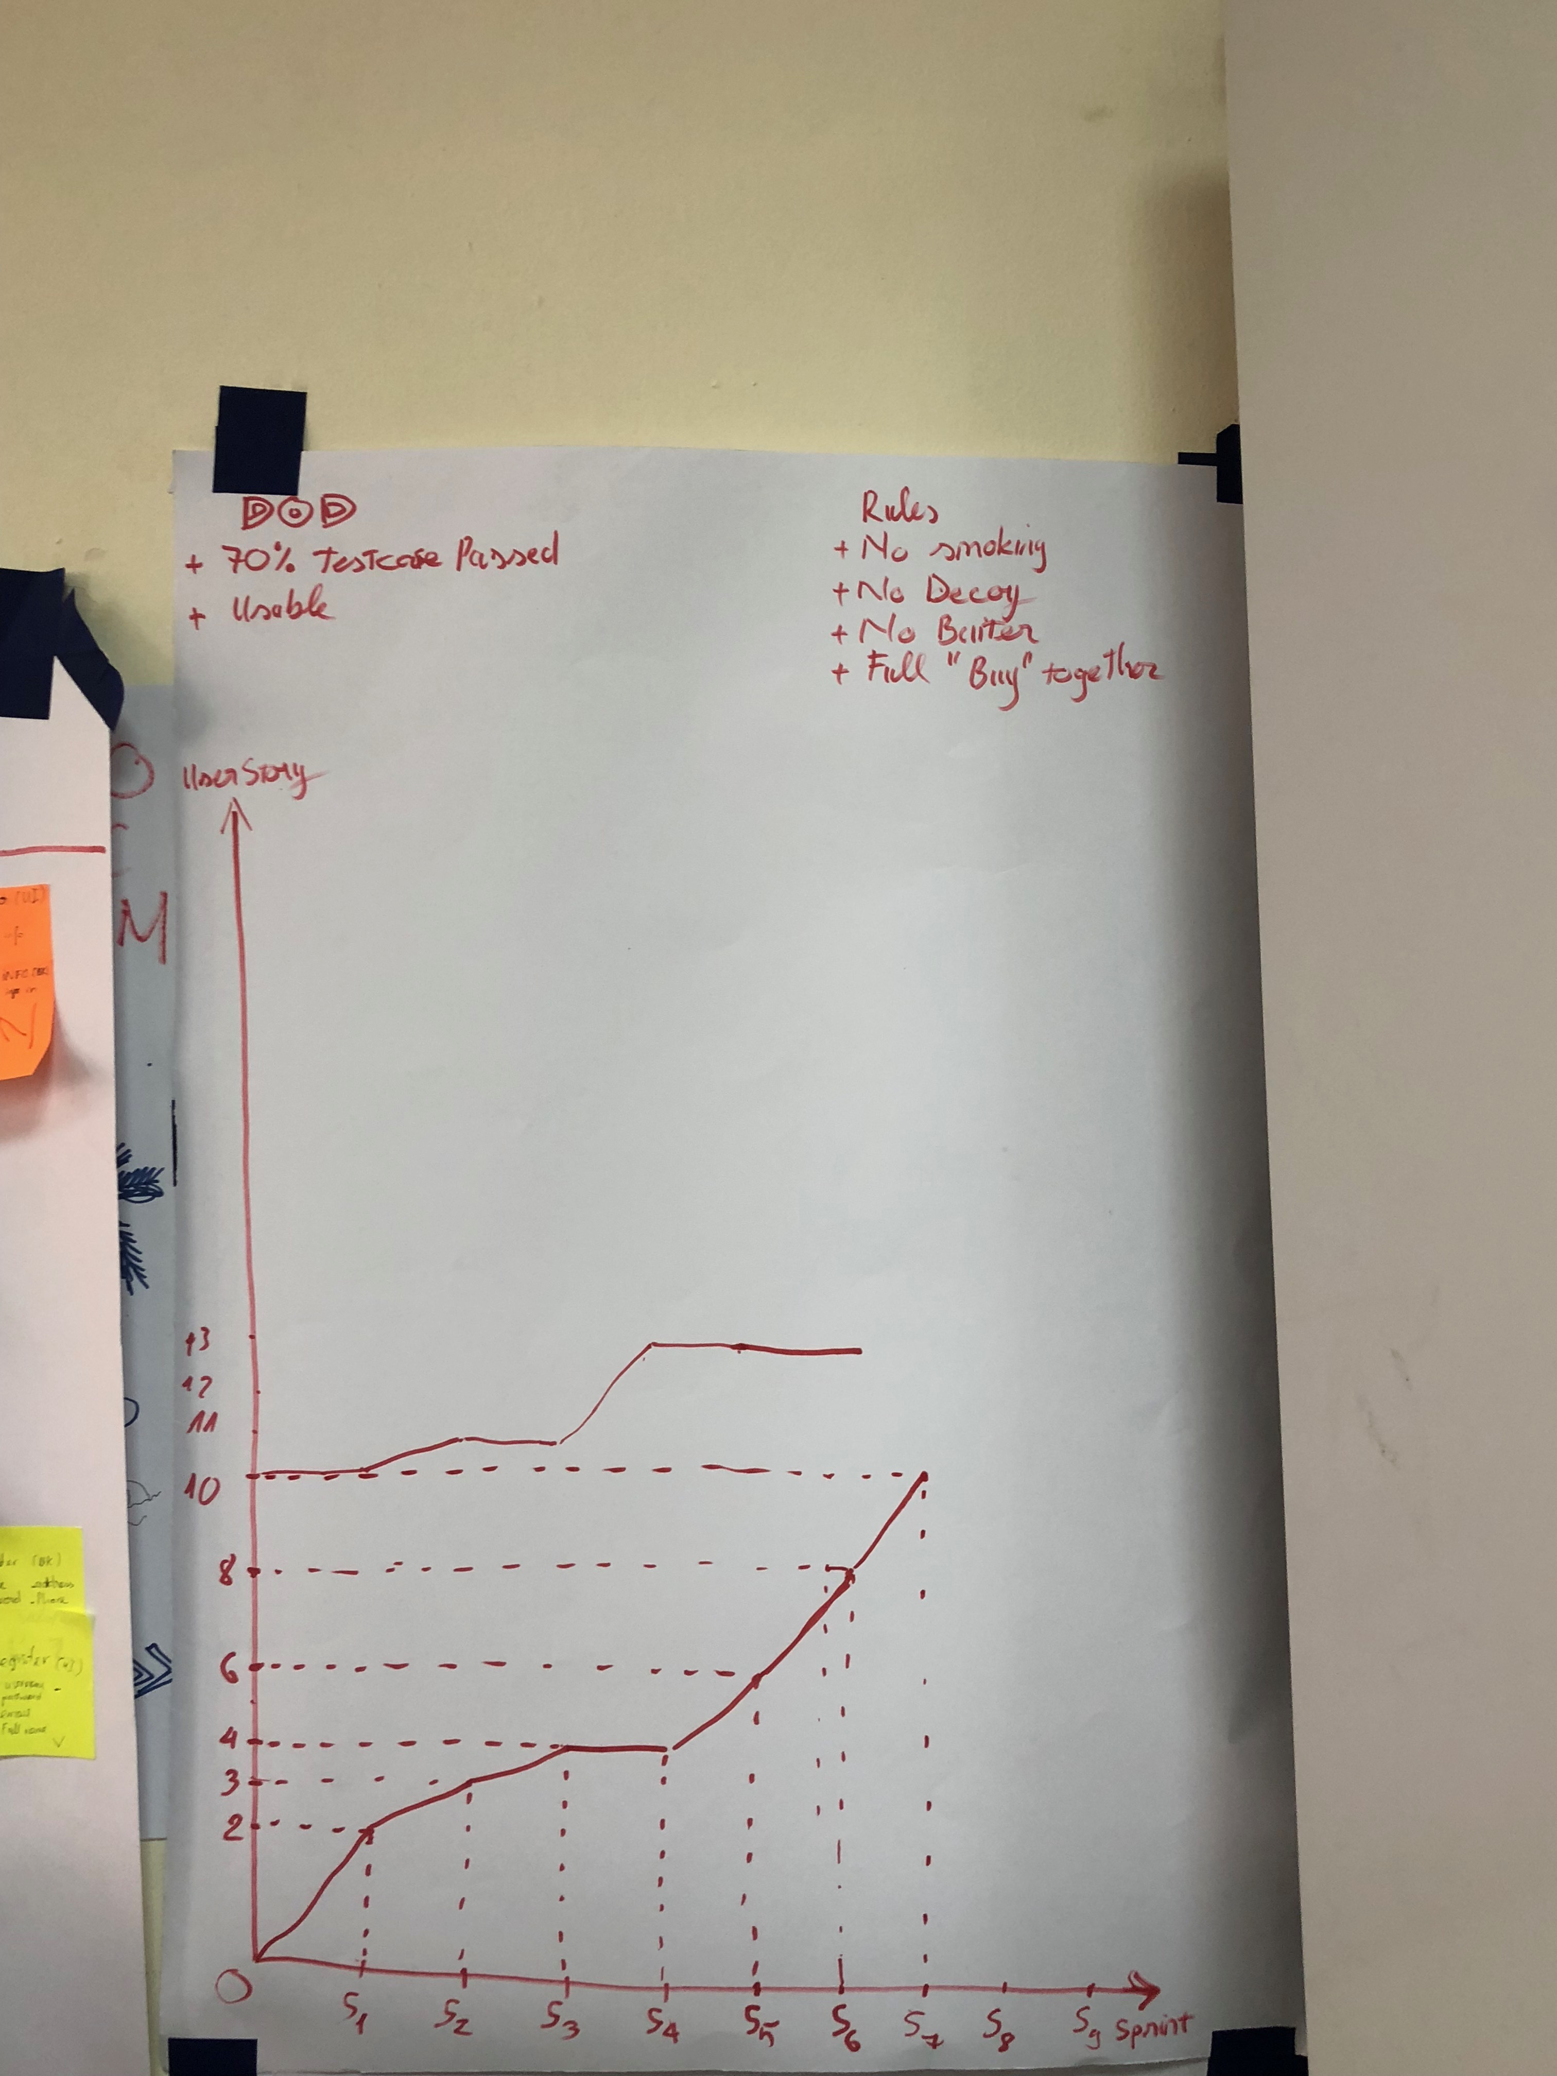
Sprint 7

Slide 16
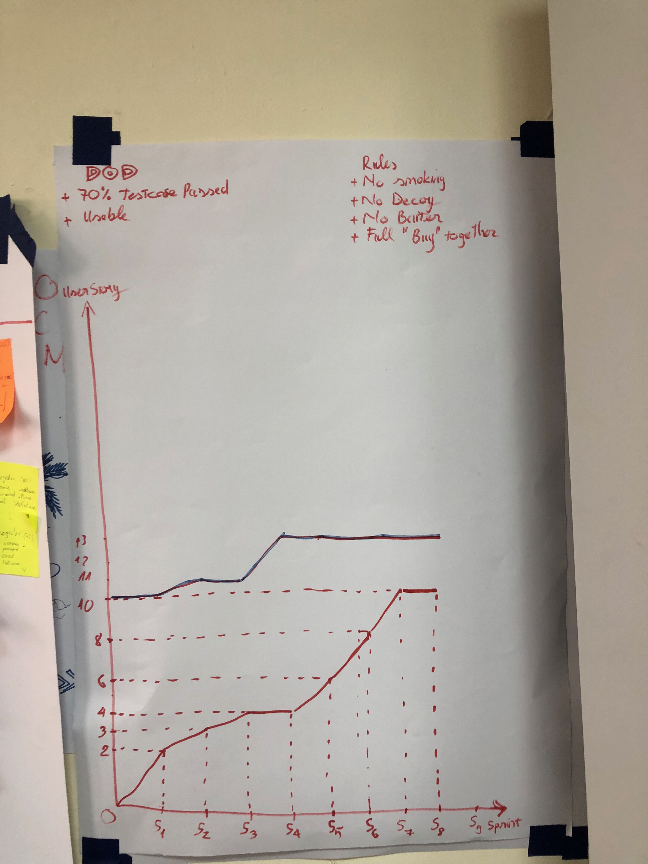
Sprint 8

Slide 17
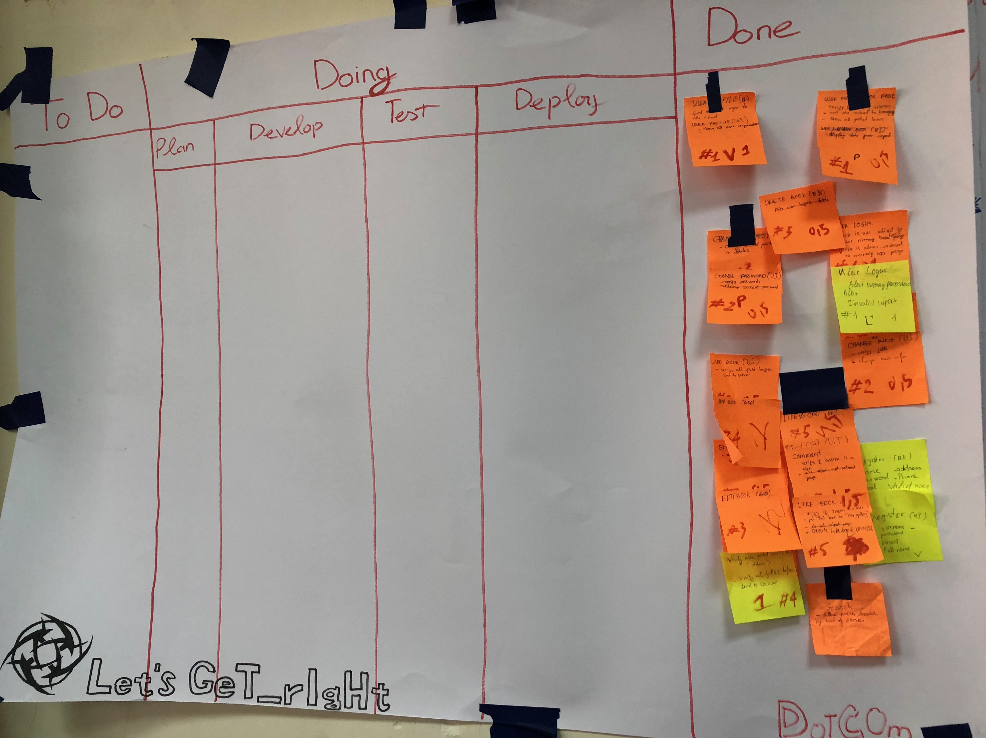
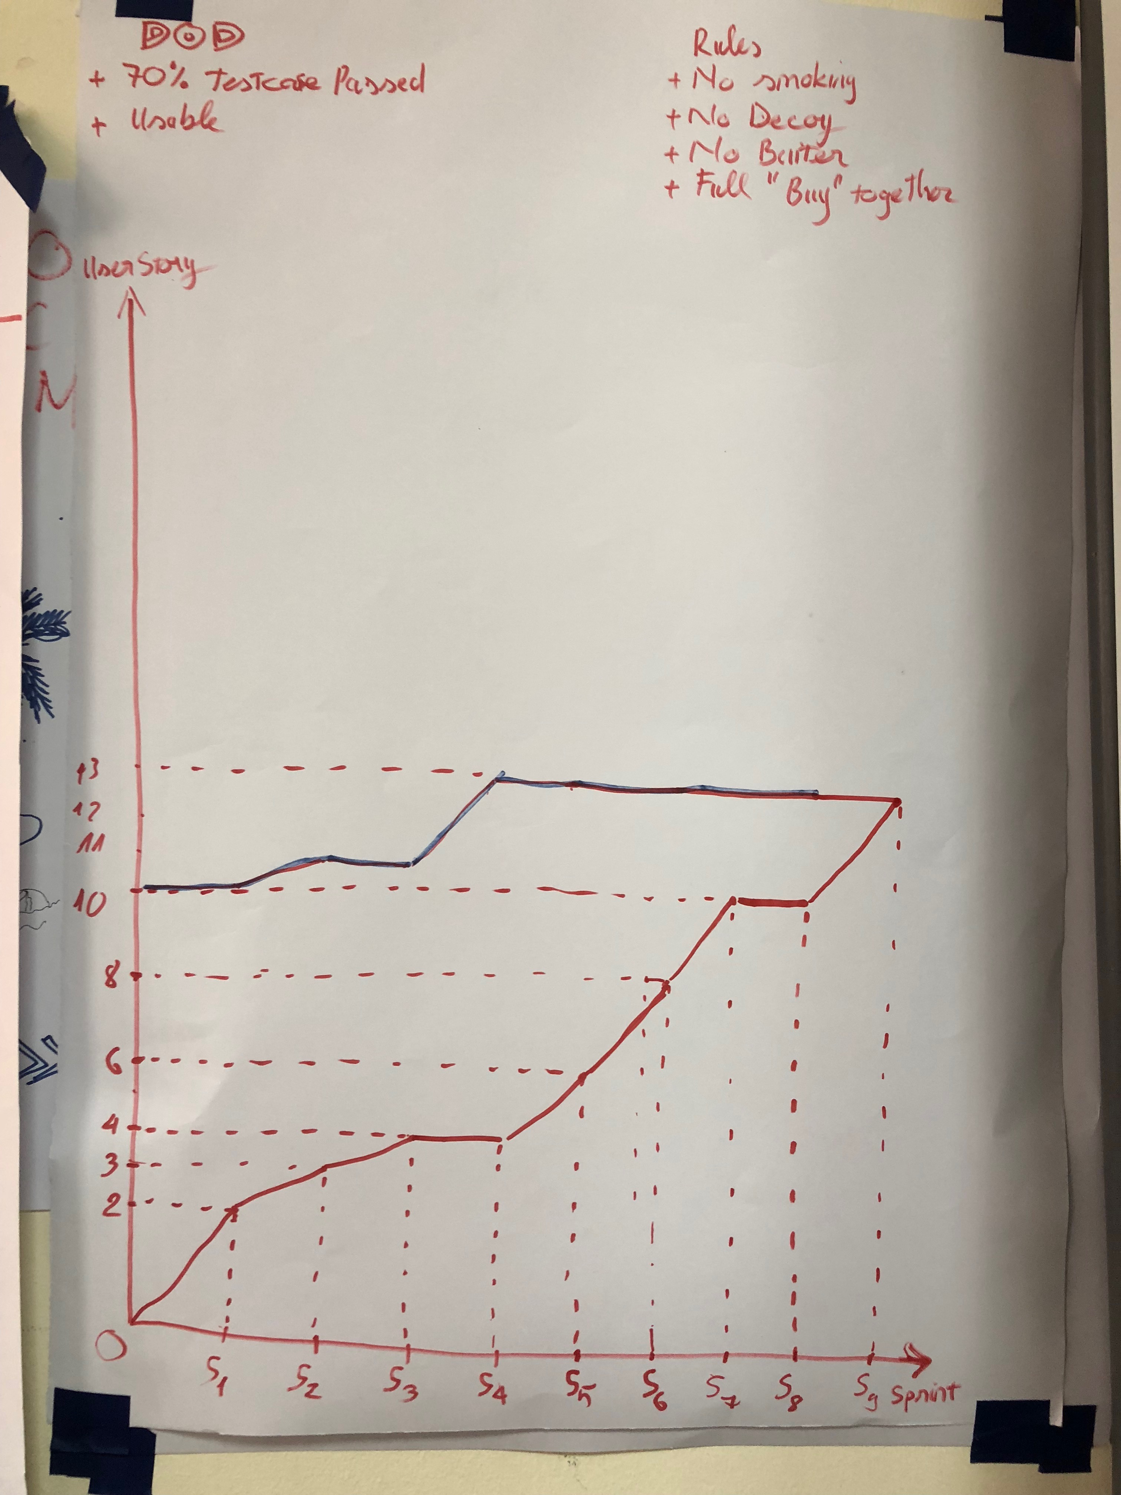
Sprint 9

Slide 18
Retrospective
GOOD
Speed
Be on time
Focus
No blame
Follow rules
BAD
Doing less test early
Daily scrums don’t solve much problem
Personal’s skill in team is not balance
Some task take more time than planning
Action

